Slide 1
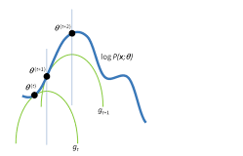
Project: Expectation Maximization Algorithm
Computational Statistics
MA 5761
Victor Apatu

Slide 2
The E-M Algorithm
The Expectation-Maximization (E-M) Algorithm is an iterative method for finding the maximum likelihood estimates (MLE) of parameters in statistical models where the data is incomplete, has missing values, or involves latent variables. the EM model simply operates on Bayesian assumption by finding a latent missing variable given what has been observed.

Slide 3
How Does it Work?
Bayesian Assumption
The E-M algorithm assumes a probabilistic framework, treating missing or latent variables as random variables drawn from a specific distribution, by estimating the posterior probability of the latent variables given the observed data.
The E-M model can be largely be classified in two (2) main steps:
Find Expectation
Maximize

Slide 4
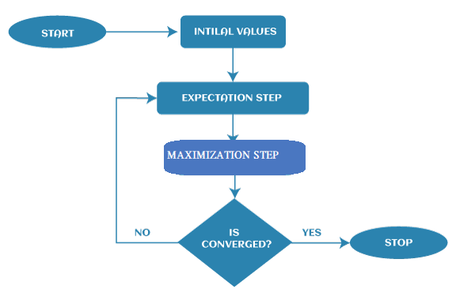

The E-M Algorithm
The E-step (Expectation)
Calculate the expected value of the latent variables based on the current parameter estimates: Think of this as “filling in” the missing data using conditional probabilities.
$Q\left(θ|θ^{\left(t\right)}\right)=𝔼_{Z|X,θ^{\left(t\right)}}\left[logP\left(X,Z|θ\right)\right].$
The M-step (Maximization)
Update the parameter estimates by maximizing the expected log-likelihood:
$θ^{\left(t+1\right)}=arg\max_{θ}Q\left(θ|θ^{\left(t\right)}\right).$
Repeat step 1 and 2 until it converges.

Slide 5
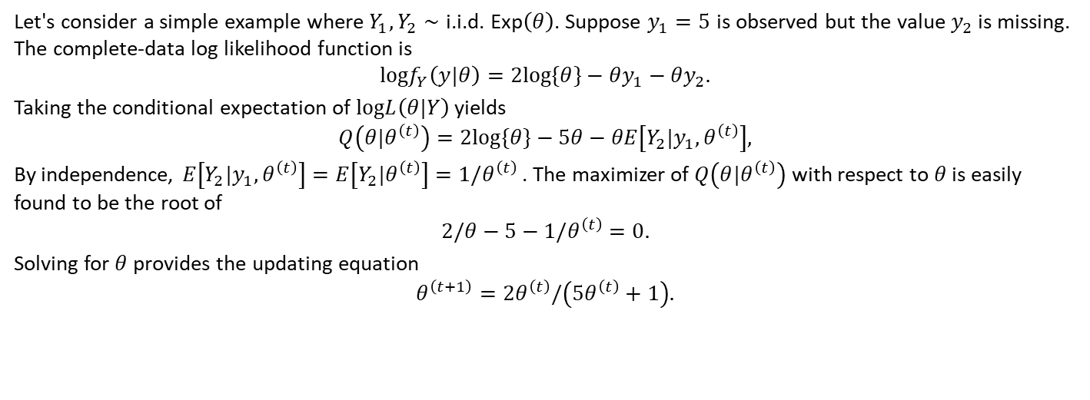
Example 1: The Simple Exponential Distribution
Let's consider a simple example where $Y_{1},Y_{2}∼\text{i}\text{.}\text{i}\text{.}\text{d}\text{. }\text{Exp}\left(θ\right)$. Suppose $y_{1}=5$ is observed but the value $y_{2}$ is missing. The complete-data log likelihood function is
$$logf_{Y}\left(y|θ\right)=2log\{θ\}−θy_{1}−θy_{2}.$$
Taking the conditional expectation of $logL\left(θ|Y\right)$ yields
$$Q\left(θ|θ^{\left(t\right)}\right)=2log\{θ\}−5θ−θE\left[Y_{2}|y_{1},θ^{\left(t\right)}\right],$$
By independence, $E\left[Y_{2}|y_{1},θ^{\left(t\right)}\right]=E\left[Y_{2}|θ^{\left(t\right)}\right]=1/θ^{\left(t\right)}$ . The maximizer of $Q\left(θ|θ^{\left(t\right)}\right)$ with respect to $θ$ is easily found to be the root of
$$2/θ−5−1/θ^{\left(t\right)}=0.$$
Solving for $θ$ provides the updating equation
$$θ^{\left(t+1\right)}=2θ^{\left(t\right)}/\left(5θ^{\left(t\right)}+1\right).$$

Slide 6
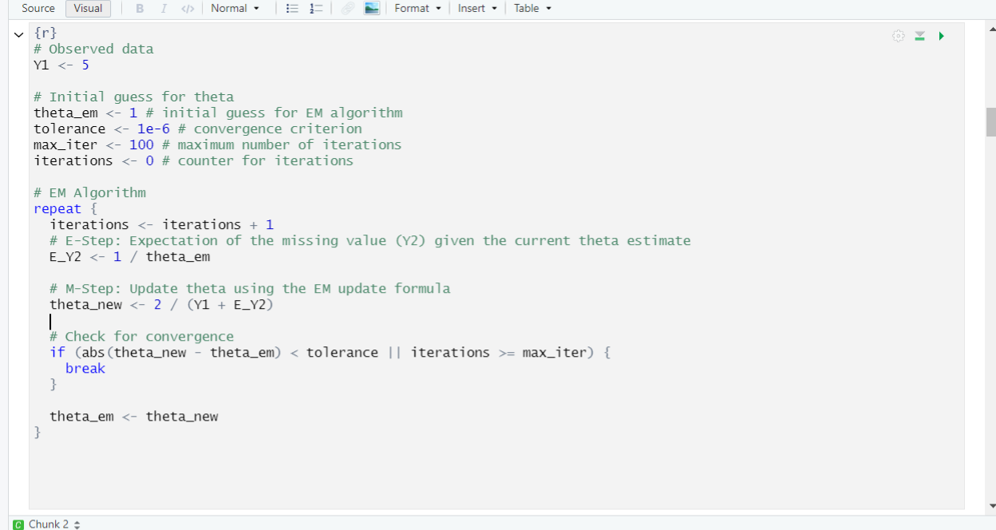
R Code </>
Results
## EM Algorithm:
## Estimated theta: 0.2000012
## Number of iterations: 18
## Traditional MLE:
## Estimated theta: 0.2

Slide 7
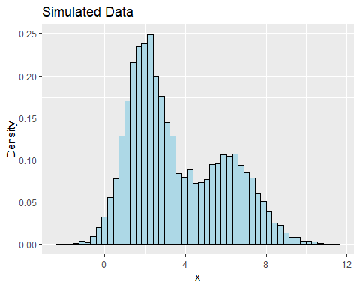
Gaussian Mixed Model
Sampling from Gaussian Mixed Model
N1(µ1 = 2, sd = 0.6)and
N2 (µ2 =6, sd= 0.4)
n = 10,000

Slide 8
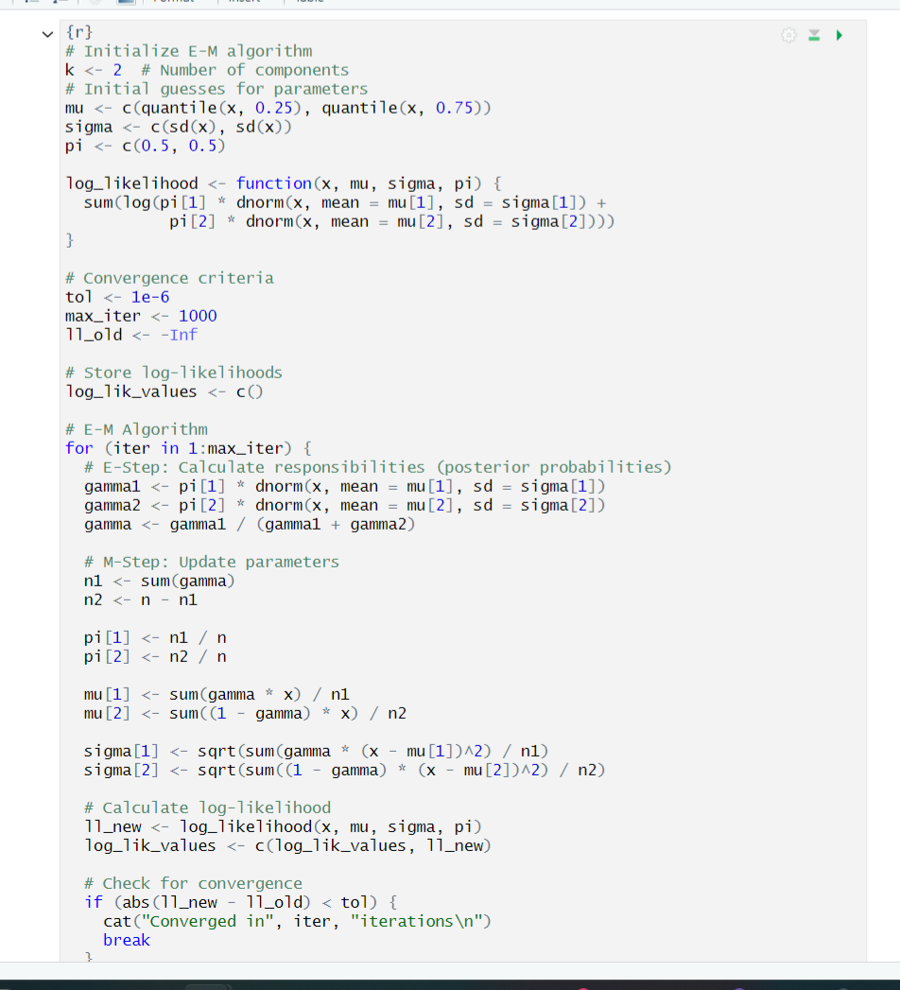
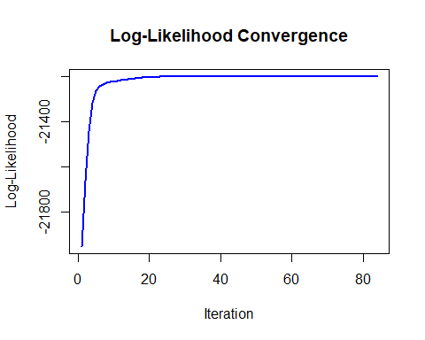
R Code </>
Results
## Converged in 84 iterations
## Final Estimates:
## Mixing Proportions: 0.605 0.395
## Means: 1.996 6.026
## Standard Deviations: 0.997 1.511

Slide 9
Variance Covariance Estimation
The E-M Algorithm can be used to find the maximum likelihood estimator (MLE) but it does not directly estimate the variance-covariance matrix of the MLEs. The E-M algorithm relies heavily on asymptotic normality of the MLEs to estimate the variance covariance matrix.
Some Commonly Known Methods include
The Hessian method –That is considered in this presentation
The Louis Method
Bootstrap method and many other “fancy ” methods

Slide 10
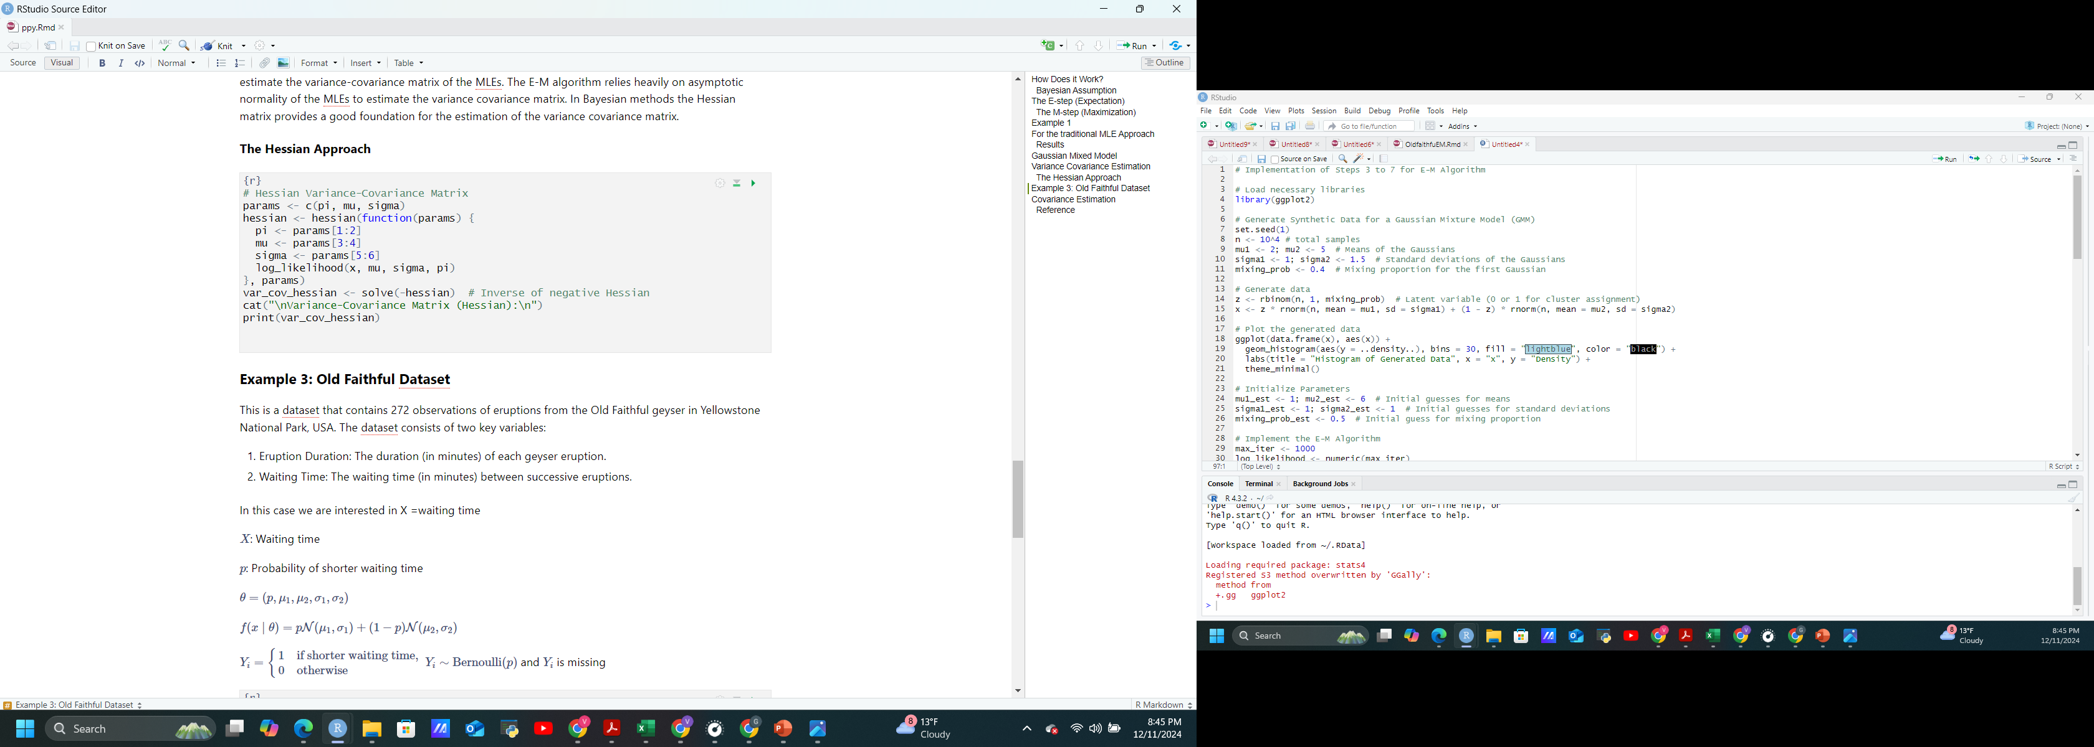
Variance Covariance Estimation
The Hessian Approach
##
## Variance-Covariance Matrix (Hessian):
## [,1] [,2] [,3] [,4] [,5]
## [1,] 9.549597e-05 -3.502555e-05 8.537454e-05 0.0002264402 5.620862e-05
## [2,] -3.502555e-05 7.455514e-05 -8.537518e-05 -0.0002264419 -5.620904e-05
## [3,] 8.537454e-05 -8.537518e-05 3.828770e-04 0.0005362058 1.508683e-04
## [4,] 2.264402e-04 -2.264419e-04 5.362058e-04 0.0020658919 3.421879e-04
## [5,] 5.620862e-05 -5.620904e-05 1.508683e-04 0.0003421879 1.938029e-04
## [6,] -1.466964e-04 1.466975e-04 -3.295882e-04 -0.0009912181 -2.004480e-04
## [,6]
## [1,] -0.0001466964
## [2,] 0.0001466975
## [3,] -0.0003295882
## [4,] -0.0009912181
## [5,] -0.0002004480
## [6,] 0.0009821870

Slide 11
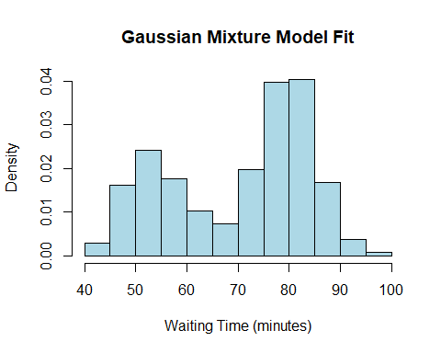
Example 3: Old Faithful Dataset
This is a dataset that contains 272 observations of eruptions from the Old Faithful geyser in Yellowstone National Park, USA. The dataset consists of two key variables:
Eruption Duration: The duration (in minutes) of each geyser eruption.
Waiting Time: The waiting time (in minutes) between successive eruptions.
In this case we are interested in X =waiting time
$X$: Waiting time
$p$: Probability of shorter waiting time
$$θ=\left(p,μ_{1},μ_{2},σ_{1},σ_{2}\right)$$
$$f\left(x∣θ\right)=p𝒩\left(μ_{1},σ_{1}\right)+\left(1−p\right)𝒩\left(μ_{2},σ_{2}\right)$$
$Y_{i}=\left\{\begin{matrix}1 & \text{if} \text{shorter} \text{waiting} \text{time}\text{,} \\ 0 & \text{otherwise}\end{matrix}\right.$ $Y_{i}∼\text{Bernoulli}\left(p\right)$ and $Y_{i}$ is missing

Slide 12
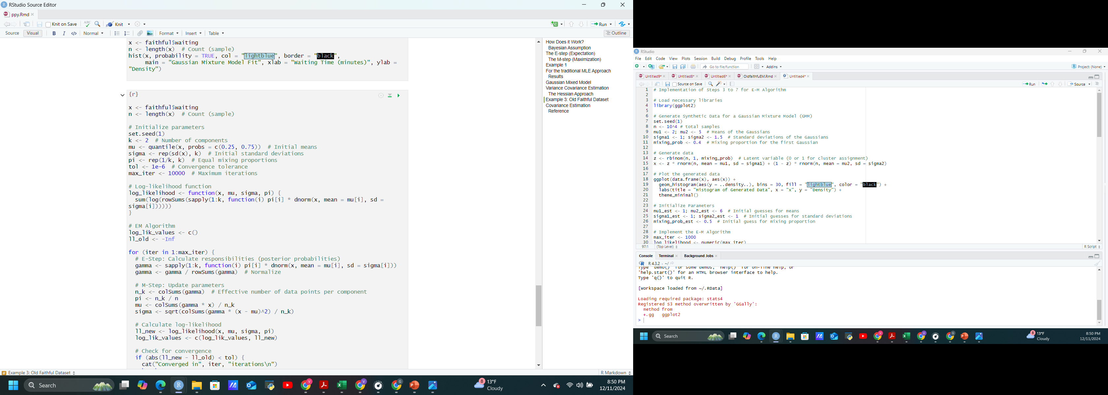
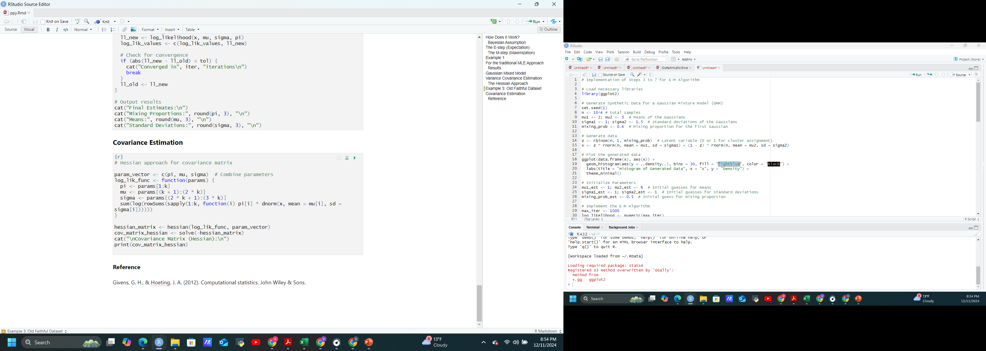
## Converged in 1522 iterations
## Final Estimates:
## Mixing Proportions: 0.349 0.651
## Means: 64.298 74.438
## Standard Deviations: 14.338 12.898

Slide 13
Covariance Estimation
##
## Covariance Matrix (Hessian):
## [,1] [,2] [,3] [,4] [,5] [,6]
## [1,] 0.05498277 -0.05369874 1.359042 0.1073731 0.1534783 0.04663065
## [2,] -0.05369874 0.05609117 -1.359041 -0.1073730 -0.1534782 -0.04663062
## [3,] 1.35904156 -1.35904066 28.241762 7.1814079 2.2333452 -2.08709354
## [4,] 0.10737308 -0.10737301 7.181408 -1.2411766 1.1929368 1.84671378
## [5,] 0.15347834 -0.15347823 2.233345 1.1929368 1.6051747 -0.69880905
## [6,] 0.04663065 -0.04663062 -2.087094 1.8467138 -0.6988091 -0.53879089
Reference
Givens, G. H., & Hoeting, J. A. (2012). Computational statistics. John Wiley & Sons.

Slide 14
Applications of E-M model
1. Estimating Gaussian Mixture Models (GMMs)
2. Learning Hidden Markov Models (HMMs)
3. Data clustering
4. Image reconstruction
5. Natural language processing
6. Filling in missing data in a dataset
1
Expectation
2
Maximize
Repeat 1 & 2 till Convergence

Slide 15
Thanks
Any Question??

